Slide 1
Infrastructure as code using Terraform

Slide 2
 What is Infrastructure as code
Automate creation and maintenance resources (servers, load
balancers, volumes, databases, middleware etc.)
Build from source control, no manual changes !!
Ensure testability
Infrastructure is described using a high-level configuration syntax.
This allows a blueprint of your datacenter to be versioned and treated as you would any other code.
State of things
Write and execute code to define, deploy and update infrastructure.
Tooling
Terraform, by Hashicorp
Libraries – boto3, fog, apache libcloud
Ansible, chef, puppet, CFengine
AWS Cloud formation

Slide 3
 Imperative
Traditional control flow programming
Build the logic
Python, java, c++, …
Declarative
JSON-like files
Define the outcomes, not how it should be done
Dependency management
Graphing
Immutable; everything is disposable
State of things

Slide 4
 As the configuration changes, Terraform is able to determine what changed and create incremental execution plans which can be applied.
 Terraform is a tool for building, changing, and versioning infrastructure safely and efficiently.
Cloud agnostic
JSON like syntax, HCL (.tf file extension)
https://www.terraform.io/docs/configuration/syntax.html
Standalone binary, written in Golang, cross-platform
Leader in Infra-as-code space, 11,000+ stars on github
Open source
Very active development cycle
You can contribute or submit issues, feature requests
https://github.com/hashicorp/terraform
Enter Terraform

Slide 5
# Create a new RHEL74 virtual machine on AWS
# https://www.terraform.io/docs/providers/aws/r/instance.html
provider "aws” {
region = ”eu-west-1"
}
Example:
resource "aws_instance” ”vm1” {
ami = "ami-c90195b0" instance_type = "t2.micro"
Declarative code
tags {
Name = "HelloWorld” costcentre = “307100”
}
}

Slide 6
# Create a new RHEL74 virtual machine on AWS
# https://www.terraform.io/docs/providers/aws/r/instance.html
provider "aws” {
region = ”eu-west-1"
}
Example:
resource "aws_key_pair” “ssh_key” { key_name = "deployer-key"
public_key = "ssh-rsa .. 2xwWdhXmXSrbX8ZbabVohBK41"
}
Declarative code
resource "aws_instance” ”vm1” {
ami = "ami-c90195b0" instance_type = "t2.micro”
key_name = “${aws_key_pair.ssh_key}”
tags {
Name = "HelloWorld” costcentre = “307100”
}
}

Slide 7
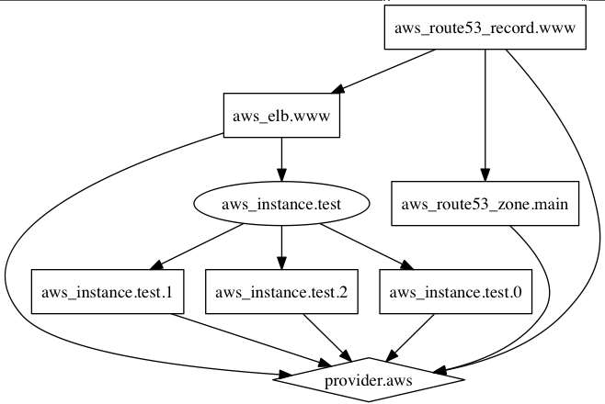
# https://www.terraform.io/docs/commands/graph.html
$ terraform graph
Example:
Dependency management

Slide 8
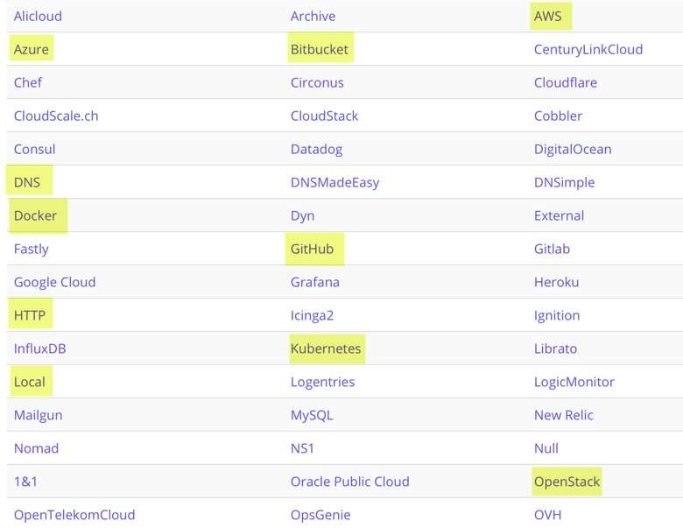

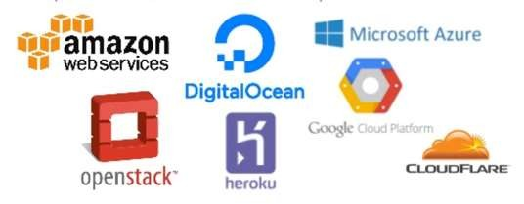
Providers generally are an IaaS (e.g. AWS, GCP, Microsoft Azure, OpenStack), PaaS (e.g. Heroku), or SaaS services (e.g. Terraform Enterprise, DNSimple, CloudFlare). https://www.terraform.io/docs/providers
A provider is responsible for understanding API interactions and exposing resources.
Example:
Providers

Slide 9
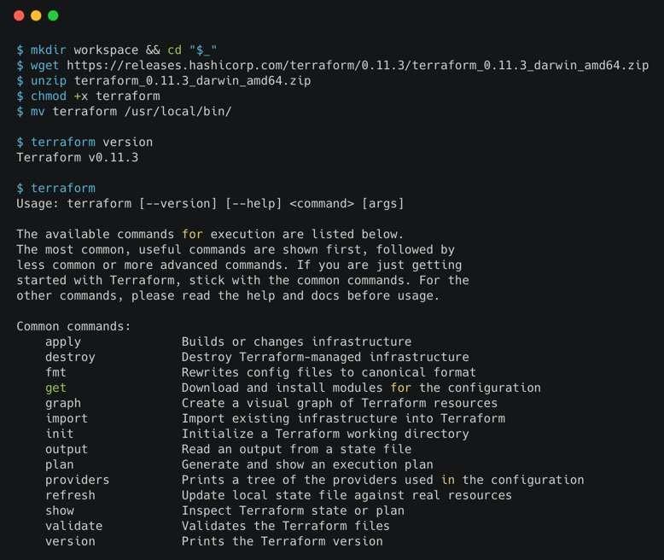
Demo time!
Download terraform: https://www.terraform.io/downloads.html

Slide 10
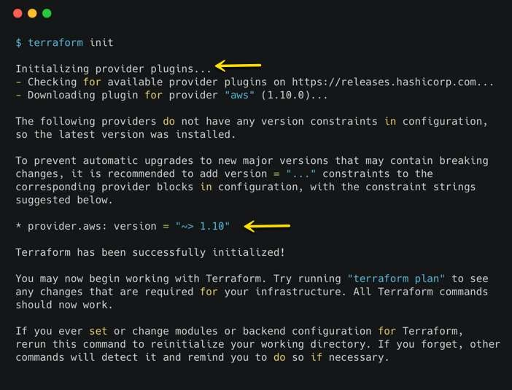
Terraform: init

Slide 11
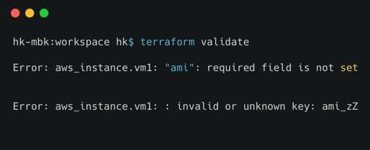
Terraform: validate

Slide 12
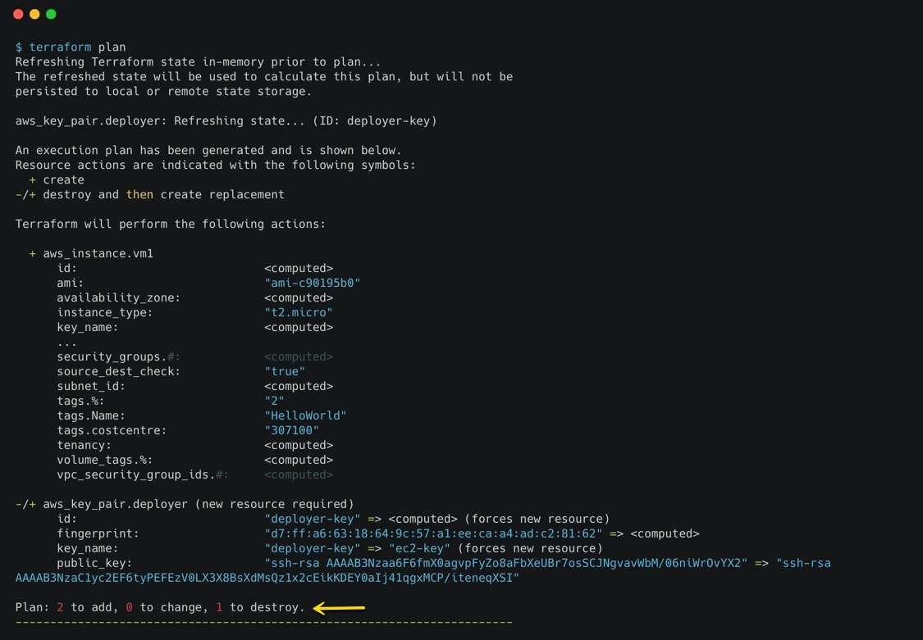
Terraform: plan

Slide 13
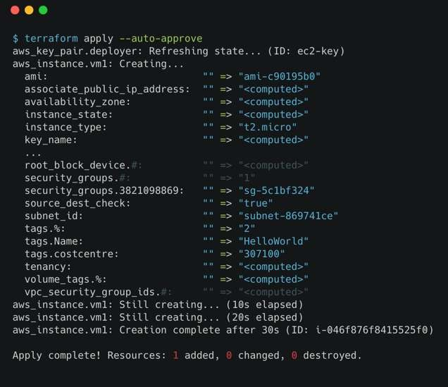
Terraform: apply

Slide 14
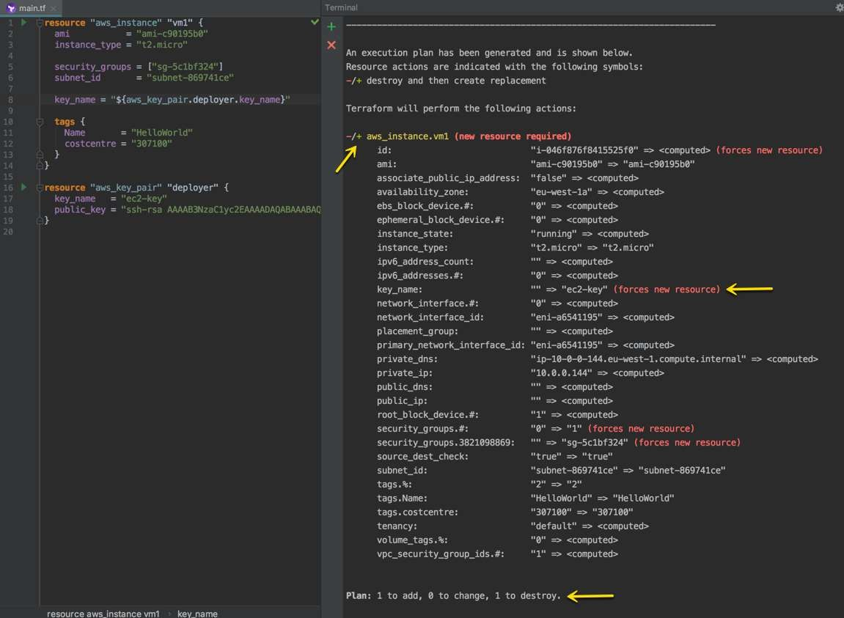
Terraform: apply

Slide 15
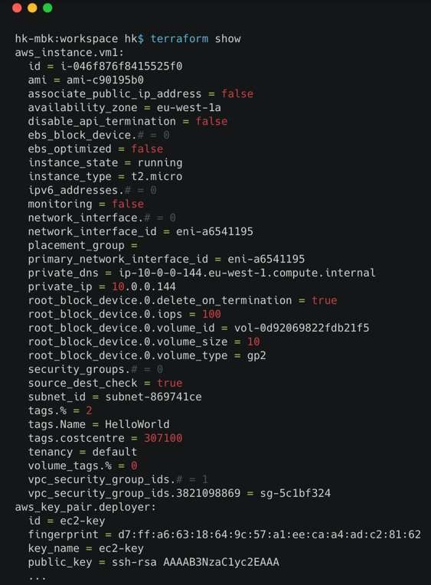
Terraform: show

Slide 16

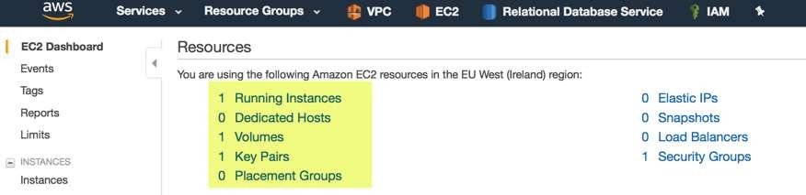

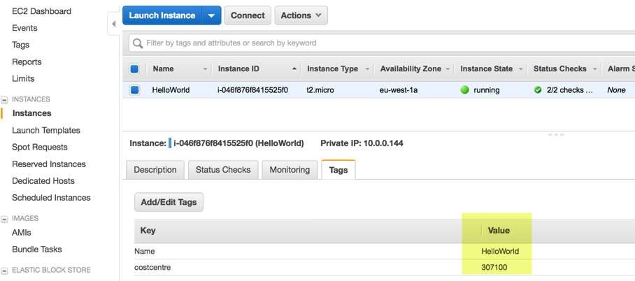
AWS console view

Slide 17
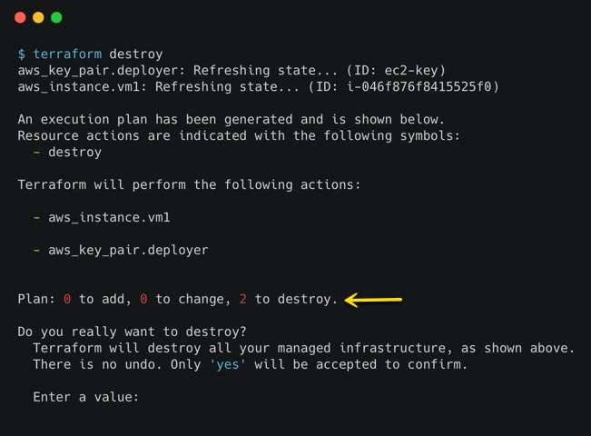
Terraform: destroy

Slide 18

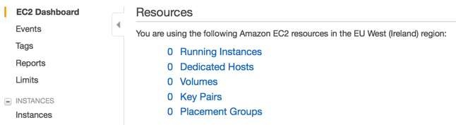
AWS console view

Slide 19
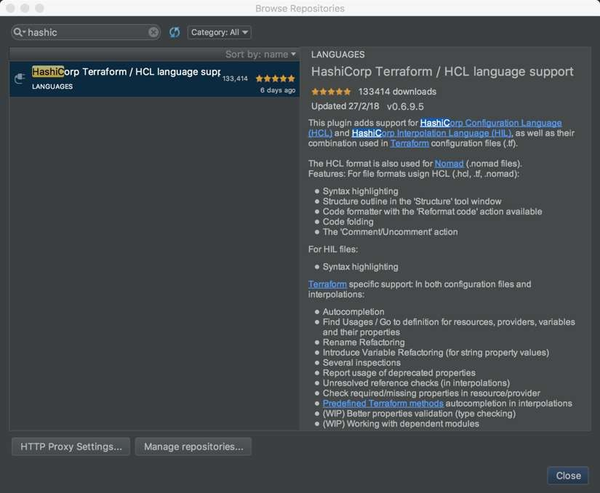

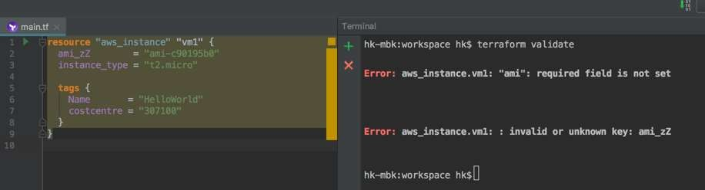
IDE Support (optional but essential)
IntelliJ, PyCharm: full featured IDE extension for auto-completion, syntax highlighting, code snippets, validation, formatting etc.

Slide 20
State files
Saves current state in a file (s3, consul, etcd, local)
Applies diff from current state to apply changes
Provisioners
Run local or remove scripts as part of resource creation or deletion.
Can be used to bootstrap, cleanup before destroy
Pre-post custom actions
Modules
DRY – don’t repeat yourself
Reuseable, ex: postgres db instance or s3 bucket
Terraform: advanced topics

